Slide 1



Business Data ETL Pipeline using Python and PostgreSQL

Slide 2

CONTENTS
1. Project Overview
2. ETL Pipeline Components
3. Data Sources
4. Technologies Used
5. Extract Phase
6. Transform Phase
7. Load Phase
8. Database Schema Design
9. Results & Insights
10. Challenges & Solutions
11. Future Improvements
12. Conclusion
13. Thank You

Slide 3

1. Project Overview
This project demonstrates the design and implementation of an ETL pipeline. Uses Python (Pandas) for processing and PostgreSQL for storage. Objective: Clean and load 2M+ business data records.

Slide 4
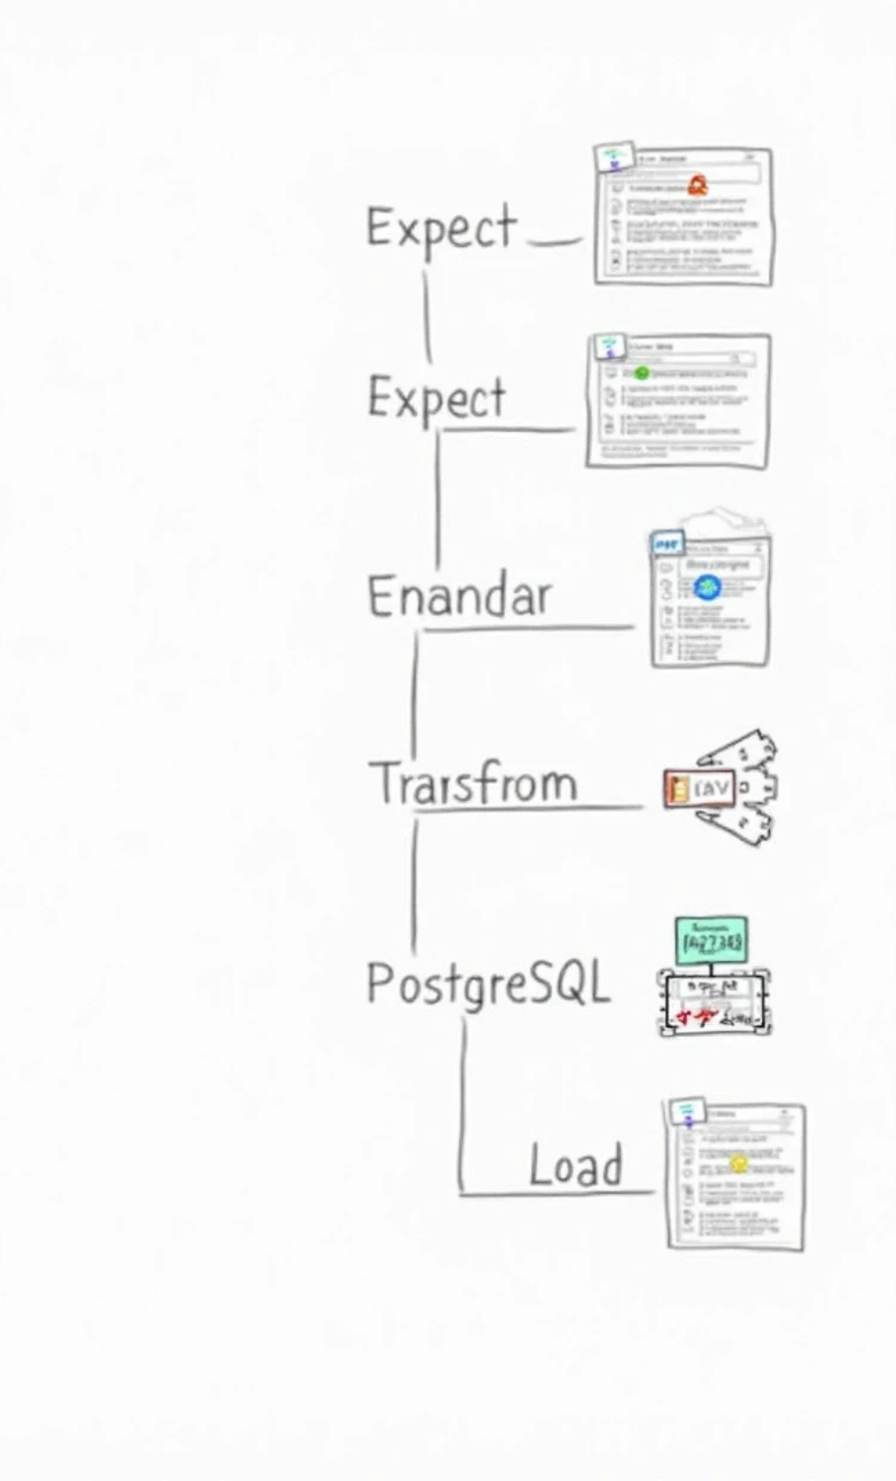

2. ETL Pipeline Components
Extract
Retrieve raw data from CSV files.
Transform
Clean and merge data using Pandas.
Load
Store transformed data in PostgreSQL.

Slide 5




3. Data Sources
1
Products
name, brand, price, stock, category
2
Customers
id, name, email, city, company
3
Organizations
id, name, country, industry, employees
Total ~2 million records combined.

Slide 6


4. Technologies Used
Python, Pandas, NumPy
PostgreSQL, SQLAlchemy, dotenv
Environment: VS Code / Jupyter Notebook

Slide 7

5. Extract Phase
Reads CSV files using pandas.read_csv(). Handles full or chunked loading for large files. Output: Pandas DataFrames ready for transformation.

Slide 8





6. Transform Phase
Clean missing/duplicate data.
Normalize text, convert types, and merge datasets.
Combine Products, Customers, and Organizations into one dataset.

Slide 9

7. Load Phase
Load DataFrames into PostgreSQL using SQLAlchemy. Batch insert 100K rows per chunk. Creates tables: products, customers, organizations, business_dataset.

Slide 10


8. Database Schema Design
Products (id, name, brand, price, stock, category)
Customers (id, first_name, email, city, company)
Organizations (id, name, country, industry, employees)
Business_Dataset (merged analytics table).

Slide 11

9. Results & Insights
ETL executed successfully!
✅ Extracted and transformed >2M rows
✅ Loaded to PostgreSQL
✅ Ready for analytics and BI dashboards.

Slide 12


10. Challenges & Solutions
Handling large data → Chunked processing
Duplicates → Drop + validation
Connection issues → Retry with SQLAlchemy
Schema mismatch → Align dynamically

Slide 13




11. Future Improvements
1
2
Integrate Airflow/Prefect for automation
Use S3 or BigQuery for scalability
3
4
Add monitoring dashboard
Connect Power BI/Tableau for visualization.

Slide 14
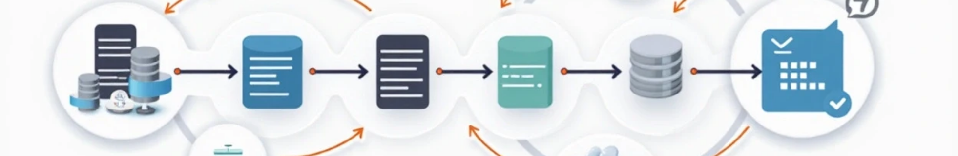
12. Conclusion
ETL pipeline showcases full data engineering workflow. Automated extract, transform, and load. Enabled analytics-ready structured data storage.

Slide 15

Questions ?

Slide 16

Thank You

